Slide 1
Image Transfer in MeasurementLink

Slide 2
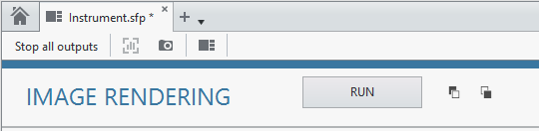
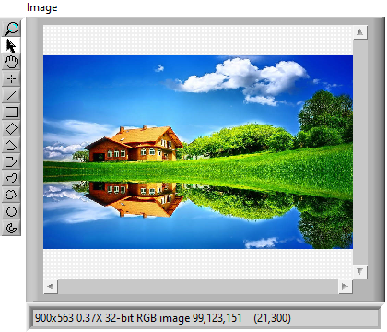
POC on Image transfer to InstrumentStudio
Unpack Configuration
Trigger from IS
Load Image from disk
Convert Image to gRPC supported type
Pack and send the result
Image data through
gRPC
LabVIEW Measurement
InstrumentStudio
Convert back to Image
+
Visualize in IS

Slide 3
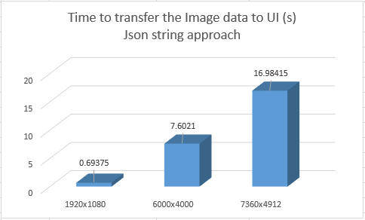
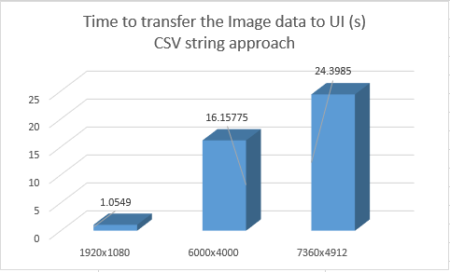
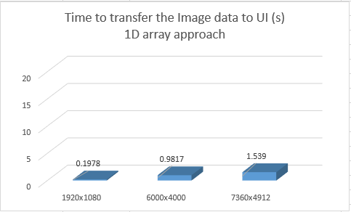
Time Taken to transfer image data

Slide 4
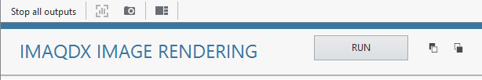
Image Streaming
Unpack Configuration
Trigger from IS
Acquire stream of images
Convert Image to gRPC supported type
7.4 ms
Pack and send the result
gRPC streaming in
loop
LabVIEW Measurement
InstrumentStudio
Convert back to Image
+
Visualize in IS

Slide 5
Approx Time Taken to transfer a frame
S.NO | Resolution (x*y) | Time Taken for sending each frame of image | Approach
1 | 1280x720 | 7.4 ms | Compressed string to byte array
2 | 1280x720 | 14 ms | U32 1D array
3 | 1280x720 | 1 sec | Json string

